Slide 1
Good Laboratory Practices
Practices and Guidelines
Dr. Richa Singh

Slide 2
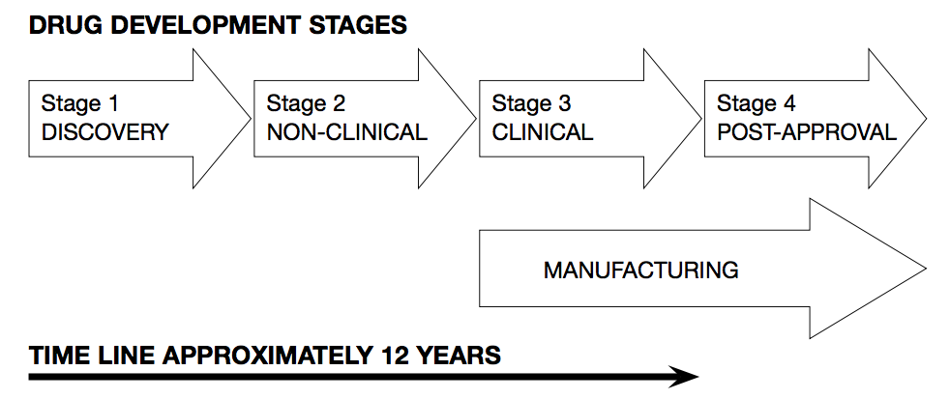

Slide 3
  Non-clinical studies [not performed in human]
  GLP
  Post approval stage
1
2
3
4
  Discovery of potential NME
  Not covered by a regulatory standard
  Clinical studies in human
  GCP
  GMP

Slide 4
History of GLP
In the early 1970s, the FDA investigated a number of cases of poor practice in toxicology laboratories throughout the USA
  Results of this investigation in about 40 laboratories
    many cases of poorly managed studies
    insufficient training of personnel
    some cases of deliberate fraud
But most of the poor practice observed was not fraud and could be dealt with by implementing a system of quality management.

Slide 5
FDA Investigation Findings:
  Poorly-trained Study Directors and study personnel
  Poorly-designed protocols
  Protocols not followed - procedures not conducted as prescribed
  Raw data badly collected - not correctly identified - without traceability - not verified or approved by responsible persons
  Lack of standardized procedures
  Poor animal husbandry
  Inadequate characterization of test items and test systems
  Inadequate resources
  Equipment not properly calibrated or otherwise qualified
  Reports not sufficiently verified, inaccurate account of study or raw data
  Inadequate archives and retrieval processes

Slide 6
FDA decision
  Introduce a new regulation to cover NON-CLINICAL SAFETY STUDIES
  GLP (Good Laboratory Practice) Regulations
    Draft of USA GLP in 1976
    Enforced in US in 1979
  Although this was a US regulation, it had a wide impact worldwide. Non-US companies wishing to register medicines in the USA now had to perform safety studies in compliance with FDA GLP.
In 1981, OECD (Organization for Economic Cooperation and Development) published GLP guidelines; these now dominate international arena with 37 member countries (as of Aug, 2020) and many non-OECD member countries (including India).

Slide 7
OECD Principles for GLP
A quality system related with the organizational process and the conditions under which non-clinical health and environmental safety studies (prospective drugs/chemical/biochemical entities) are planned, performed, monitored, recorded, archived and reported
GLP principles are a set of organizational requirements
  The regulations are not concerned with the scientific or technical content of the research programmes
  They do not aim to evaluate the scientific value of the studies

Slide 8
Significance
GLP promotes Quality and Validity of test data
Help scientists to obtain results that are “Reliable, Repeatable and Auditable”
To minimize the incidence of false negatives
  E.g. result demonstrate non-toxicity of a toxic compound
To minimize the incidence of false positives
  E.g. result demonstrate toxicity of a non-toxic compound
To promote mutual recognition of study data across international frontiers
Limit waste of resources, especially animals
Ensure comparability of results between candidate medicines

Slide 9
GLP and Non-Clinical Study
1
  Planning
    Study plan / protocol and planned changes
  Performance
    SOPs
  Recording
    Collection of raw data, recording deviations
  Reporting
    Accurate result reporting
  Archives
    Study data, specimens, samples and reports
  Monitoring
    Study staff, QA personnel, national inspectors
2
3
4
5
6

Slide 10
GLP: Basic Points
Resources
    Management
    Personnel
    Facilities : Building & Equipment
Characterization
    Test item
    Test system
Documentation
    Study plan
    SOPs
    Raw data & data collection
    Final report
    Archiving & indexing
Quality Assurance
    Review of study plan & SOP
    Planning
    Audits and inspections
Validation

Slide 11
1. Resources
Management
1
Personnel
2
Building
3
Equipment
4
GLP requires that all resources be adequate for the task at hand

Slide 12
1A. Management
Overall responsibility for GLP implementation
  Must provide proper resources –
    Personnel
    Facilities / Equipment
  Should demonstrate that the resources are suitable for the task
  Promote good science and good organization
  Implementation of GLP
Each test site or test facility retains a document identifying individuals with management responsibilities

Slide 13
Good Science
  Experimental design
  Based on known scientific principles
  Knowledge of experimental variables / bias
  Interpretation of results
  Results become part of accepted scientific knowledge
Good Organization : COVERED BY GLP
  Planning of studies and resource allocation
  Adequate physical facilities
  Sufficient qualified staff – recruitment
  Definition of staff responsibilities
  Staff training
  Proper conduct of studies
  Good record keeping and organized archives
  Verification procedures for study conduct and results

Slide 14
PLANNING / RESOURCE ALLOCATION
  Management responsibility
  Sufficient physical resources and personnel were available to perform studies compliant with GLP
  Master schedule is a document that records the planning of the all studies performed at a site.
    Assist in assessment of workload
    Track studies at a test facility
MASTER SCHEDULE

Slide 15
MASTER SCHEDULE
  Approved by Management
  All studies should be included
    Important for planning aspects
    Proper allocation of resources
  Keep up-dated and have a change control procedure
  Include actions such as protocol review and report preparation
  Have only one official schedule
  Define the system in an SOP
  Decide who should maintain this document
  Archive – as necessary
  Distribute to those who need it, especially QA team

Slide 16
1B. Personnel
Study Director
1
Single point of study control
Principal Investigator
2
    Acts on behalf of study director for a multi-site study
Study Personnel
3
    Perform study according to the instruction
Quality Assurance
    Ensures management of GLP compliance
4
Archivist
5
Manages archives
Management is responsible for appointing trained persons to perform work

Slide 17


Organization of resource ‘personnel’ in standard documents
Organization Charts
  Up-to-date chart should be provided by management
  Should give a good idea of how the organization structured – who reports to whom
  Keep it simple
    May indicate no. of staff present in each department
      Small organization – names of staff
      Large organization – job title
    Add functional responsibilities only if this helps to explain the organization
Curriculum vitae
  For all personnel
      Even for staff without formal qualifications
  In standard format
  Up-to-date
  Archived
  Contains
      Qualification / education / diplomas
      Professional experience

Slide 18


Training Records
  Past
    Induction to the job
    Competence of personnel regarding SOPs
    External courses / internal courses
    Attendance at seminars
  Future
    Training plans for each member of staff
  Up-to-date
  Archived
Job Descriptions
  Clearly define day-to-day responsibilities and tasks
  Make it clear who reports to whom
  Describe the delegation of tasks
  Up-to-date in Standard format
    Department /group
    Name, position, level
    Name, position of supervisor
    Position summary
    Tasks and responsibilities
    Approval signatures and date
  Signed by person concerned and his/her immediate supervisor
  This is not a GLP requirement but is a good practice to ensure that both parties understand their respective responsibilities (which is a GLP requirement)

Slide 19
1C. Buildings
GLP regulations do not stipulate exactly how buildings should be constructed.
It is up to management and study staff to satisfy authorities wrt
  Suitability / Adequate for the study
    Size, construction, location
    Free from interference, disturbance, pollution and cross-contamination
  Adequate separation
  Maintenance
  Documentation including site plan

Slide 20
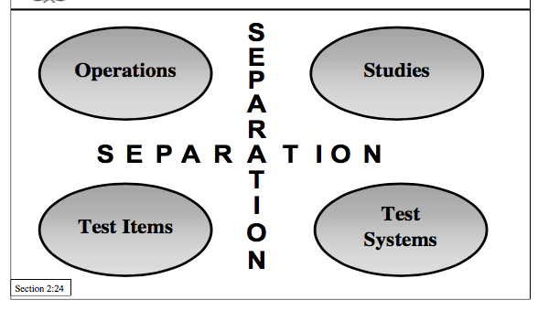
FACTORS TO CONSIDER
  Experimental
    Test systems
    Study types
    Number of studies
  Staff
    Safety and comfort
    Possible impact on study from staff
  Operational
    Access / security
    Cleaning
    Storage
    Utilities and maintenance
    Waste disposal

Slide 21
1D. Equipment
GLP regulations require that equipment used in studies
  Suitable for task in hand
  Properly calibrated and maintained
SUITABILITY
  Study director’s responsibility
    Study staff must be able to justify the use
  Sometimes requires proof of suitability
  May need formal equipment qualification
CALIBRATION
  Need proof of standard working conditions
    Working within limits fixed by the manufacturer
    Producing reliable data
  Calibration usually requires use of standards
  Fix frequency of calibration in SOP
  Respect calibration frequency

Slide 22





Building & Equipment
Records
SOPs
  Use logbook
  Calibration / checks
  Maintenance service plan
  Fault action reports
  Use of computerized systems - Developed, validated, operated, maintained
  In GLP compliance
Maintenance
  Preventive maintenance
  Curative maintenance (fix it when it breaks)
  Back-up equipment
  Contracts with external service organization
  Alarms
  Use of building / equipment
  All maintenance actions including outside contractors
  Service plans

Slide 23
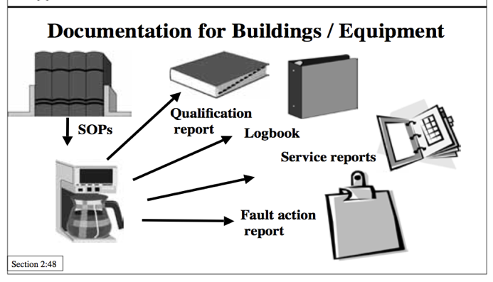

Slide 24
2. Characterization
Materials used in experiments
Non-clinical studies
  Test item
    Often a chemical compound
    Active ingredient for a medicine, a pesticide, a food additive, a vaccine, a biomass, an extraction from plant tissue, etc
  Test system
    Often a live animal
    Plant, bacterium, an isolated organ, a field or other ecosystem, etc

Slide 25
2A. Test Item
The GLP regulations deal with three points:
  Test item itself
  Preparation of dose formulation i.e. formulation of test item
  Chemical analysis of both test item and formulation of test item

Slide 26
TEST ITEM
  GMP is not required for the manufacture of batches used in preclinical GLP studies
  However, regulatory authorities do require testing to ensure that test items are suitable for non-clinical studies
  Identity of test item is ascertained
  Protect test item from cross- contamination or pollution
  Use single lot throughout the study, if possible
  Ensure that there are traceable (track) records for all test items
  Characterization of test item is essential to ensure no major quality problems
  Quality should be as similar as possible to the compound to be used in clinical trials
    Chemical production changes can lead to physico-chemical variability
    Physico-chemical variables affect bioavailability

Slide 27
FORMULATION
ANALYSIS
  Has the dose-form
      The right test item?
      The right concentration?
      Always been prepared in the same way?
  Have you got traceability procedures for
      Receipt?
      Storage?
      Preparation?
      Delivery to point of use?
      Disposal?
  Identity, activity and bioavailability of test items
  Quality of test item and dose formulation
  Constant nature and no degradation over time
  The study director should have this information ASAP
  The data from analyses must be reliable, hence should be generated under GLP conditions

Slide 28
2B. Test System
Animals, Bacteria, Cells, Organs, Plants
GLP compliance
Compliance with animal welfare legislation (for animal test system)

Slide 29
ANIMALS
  Scientist must match quantity and quality of animals to research requirements
  Study Director defines
    Phenotype / genotype
    Sex, age
    Supplier
    Number
  Reason for selecting the test system should be mentioned in Study Plan
  Selection may be based on
    Species / strain
    Health status
    Background data

Slide 30
  Procedure for assignment to groups in the protocol
  Keep data used for assigning groups
  Log locations of rack / cage, if applicable
  Document all cases of “disqualification”
  Inspect upon arrival – SOP
    (Number delivered, Number ordered, Health, Sex, Weight, Age)
  Record receipt and any deviation from SOP
  Check against protocol requirements
SUPPLY
RECEIPT
HUSBANDRY
GROUPING
  Assess quality by supplier qualification
    Usually by scientist + QA
  Apply same to bedding and animal feed
  Keep order form, supplier’s invoice, transport certificate etc.
  Follow national regulations
  Routine checks
    (Rooms – cleaning, Cages / racks – cleaning, changes, Feed / water, Environmental parameters – temperature, humidity, light, air)
  Document the routine checks
  Document having deviations from SOPs

Slide 31
  Length depends on species / protocol
  Health check at specified times
  Document preparation / approval of study room
IDENTIFICATION
ACCLIMATIZATION
ENVIRONMENT
  Identification during acclimatization & study
  Large animals (individual marks throughout)
  Small animals (cage labels for acclimatization → individual unique ID for study)
  Animal ID on all data
  Regular ID check
  GLP requires “..a description of all circumstances that may have affected the quality or integrity of the data”
  Environmental conditions belong to these circumstances.

Slide 32

3. Documentation
Institute’s rules for organizing and conducting GLP studies must be documented → approved by management
  Formal documents
  Must be scrupulously followed
  Rules define who does what, how, when & where (sometimes why)
Two main types – (i) Study Plan / Protocol & (ii) SOP
PRESCRIPTIVE DOCUMENTS
  Descriptive nature
  Followed as per the given format / standard
Includes
  Data collection
  Final Report
DESCRIPTIVE DOCUMENTS

Slide 33
A. The Protocol or Study Plan
WHAT?
CONTENT
Defines study design
Overall plan of experiment
Info on major events of the study
  Provides enough information about the methods used to perform the study
  May follow international scientific guidelines (optional)
Must be approved by the Study Director, even if the study is sponsored by another organization
Provides overall timeframe → “MASTER PLAN”
  Scientific requirements of the study
  Comply with GLP
      Identification number
      Title and statement of purpose
      Identification of test (and control) items
        Chemical names/codes/specifications
      Name of sponsor & address of test facility
      Name of study director and other responsible personnel
      Proposed dates
      Justification for selection of the test system
      Description of test system
      Experimental design
        Dosing details / parameters

Slide 34
APPROVAL
DISTRIBUTION
  Sponsor and study director must agree on design of the study before it begins
  Provides sufficient time for all staff to be made aware of their roles in the study
  Mandatory signature by Study Director with date
      Marks the date of study initiation
      Represents his/her agreement to take full responsibility for the study
  Sufficient time must be allowed to
      Produce protocol
      Discuss its implications with concerned staff
      Circulate protocol for QA review
      Circulate protocol for scientific review
      Circulate approved version to all staff involved in the study
  Easy access to a copy of the protocol to all staff members involved in study.
  In order to confirm that this is so, it is worth obtaining a signature from each recipient.
  It is good practice, but not a GLP requirement, to hold briefings/meetings before the study begins to ensure that everyone is aware of their role in the study.

Slide 35
PROTOCOL AMENDMENT
  Regulates the conduct of the study
  Can be changed to allow study director to respond to results or other factors during the course of the work
  If amended → documented and explained
  Study director will write a “protocol amendment”
    Issued to document a prospective change in the study design or conduct
  Unplanned changes, omissions, errors in study →
    not covered by protocol amendment
    not acceptable practice
    can be documented in a file note attached to relevant raw data
  Planned amendment is a part of protocol amendment
    Study being amended is clearly identified
    Amendment uniquely numbered
    Reason for amendment is clear and complete
    Section of original protocol being amended is clearly identified
    New instruction is clear
    Approved by study director and properly reviewed
    Distribution is same as that of original protocol

Slide 36
Pivotal document for
  Communication to study staff
  Fixing study objectives
  Contractual reasons
    E.g. between contact laboratory and sponsor
  Providing basic dates
    Study start and finish dates
  Indicating study methods and specifications
  Defines responsibilities and resource needs
  Basis for regulatory discussions

Slide 37
B. Standard Operating Procedures
1
3
2
INTEGRAL PART OF GLP
Provide detailed in-depth instructions for all routine & lab processes
  Necessary addition to protocol if a study is to be repeated exactly
SOPs only apply when there is a standard practice which will be repeated
If the work perform is not routine, there is no need to write an SOP.
The instructions can be included in protocol or lab document
Part of laboratory master documentation system
Needed for all sectors that ensure the GLP environment

Slide 38
4
6
5
Content or sections of SOPs :
Title
Purpose
General
  Highlights principal features
  Gives background information
Procedure
  Instructions in logical / chronological order
References
Help
  Contact person in case of problems
Cover all activities:
Technical aspects of study
Administration
Transfer of data to archives / managing documents
Personnel management
Safety
Hygiene
Readable, clear, precise, practical
Fully understood and followed
Reviewed

Slide 39
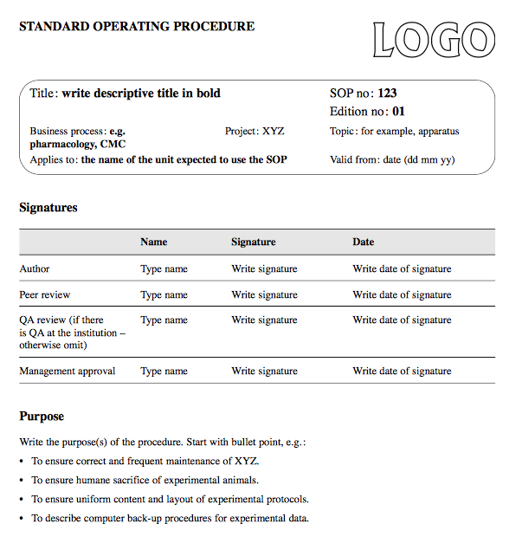

Slide 40
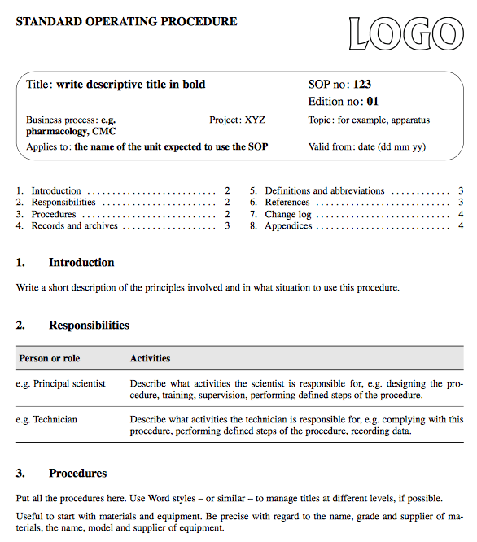

Slide 41
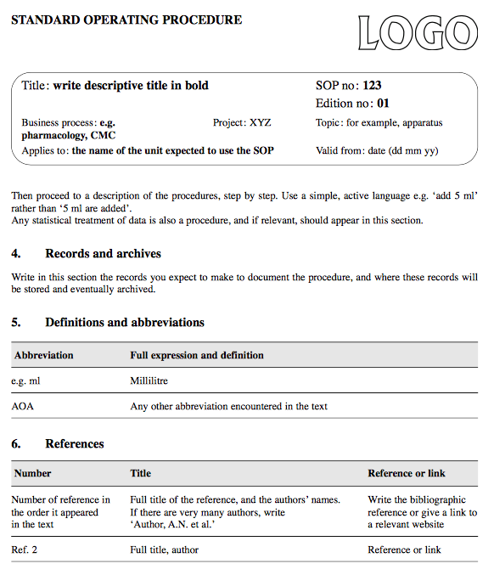

Slide 42
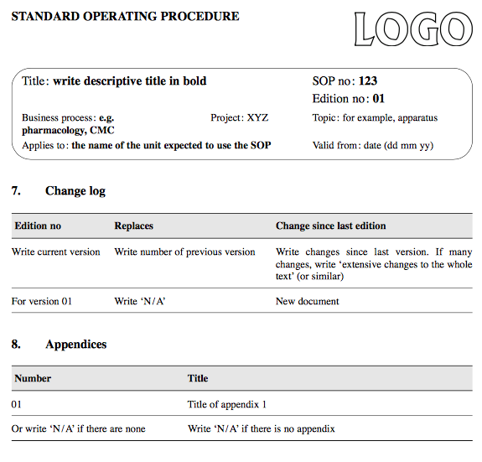

Slide 43
SOP IMPLEMENTATION
BENEFITS OF GOOD SOP SYSTEM
  Management support
  (Must be convinced of the advantages that good SOP system can confer)
  Training to SOPs
  (Educating tool, Compliance with GLP)
  SOP management system
  (Up-to-date SOP, Standardization, Accuracy of results)
  Standardized, consistent procedures, reduce test-to-test variability
  Means of study reconstruction
  Optimizes the way things are done
  Record technical and administrative improvements
  Approval by management formalizes their commitment to quality
  Ease of documenting complicated techniques
  Continuity in case of personnel turnover
  Forms training manual
  Means of communication (audits, visits, technology transfer)
SOP MANAGEMENT
  Responsible person for each SOP
  SOP must be immediately available
  Formal change control : any changes in SOP must be made following a standard method, describing in an SOP → historical reconstruction
  Central organization (optional)
  Set standard format
  Single point for i.d./numbers / issuance
  Change control (versions) : traceability
  Ensure distribution
  Ensure cross-departmental coherence of SOPs
  Ensure review by QA unit

Slide 44
C. Raw data and data collection
Experimental phases of the study generate data
Information becomes part of the scientific base of knowledge, if they reach public domain
Results include:
  Raw data
  Study files
  Data on environmental conditions, etc
These are DESCRIPTIVE documents
They give us the result of the experiment
Tell us who did what, when, where and how

Slide 45
1. Before the study
Data collection requires
  Adequate well-trained staff
  Appropriate equipment
  Good preparation with planning records available
  Complete instructions
  Study Director should ensure
  Sufficient trained personnel
  Protocol is understood and available
  SOPs available in work areas
  Equipment handy
  Data collection forms available in work area and ready for use
Operator should ensure proper functioning of equipment
2. During the study
Raw data
  Original, first, on-the-spot record
  Needed for the study reconstruction
  Lost / inaccurate data may invalidate the study
  Collect data on prepared forms / notebooks to indicate:
    WHAT was done
    HOW it was done
    WHEN it was done
    WHO collected the data
  Records are more than just a list of figures
  Data should be recorded
    Directly / not transcribed from a rough copy
    Promptly, Accurately, Legibly, Indelibly
    Explain corrections
    Sign and date

Slide 46

  Data should show
    That the protocol was followed
    That the process complied with SOP instructions
    The results of observations
  Data should show that methods were carried out
    As indicated in the protocol and SOP
    Or that any deviations from protocol or SOP were recorded
“What” was done?
“How” was it done?
“Who” did it?
“When” was it done?
  Data should
    Identify the operator
    Identify data recorder – if different from operator
    Identify verifiers / correctors
  Data should show
    Timing as per protocol – date / time
    Any deviations from protocol schedule were recorded

Slide 47
  Data should be
    Collected together in one place
    Organized in logical order
    Verified for completeness
    Handed over to the Study Director
    Kept in a safe place for easy archiving
3. After the study

Slide 48

D. Final Report
Name & address of test facility
Name of Study Director
01
QA statement of audits / inspections
08
Dates of study (start & finish)
Study objectives
Signed/dated reports from scientists
02
07
GLP REQUIREMENTS OF
FINAL REPORT
Test item / system details
Dosing details (routes / duration)
03
GLP compliance statement signed by Study Director
06
Results & Statistics
Summary of findings
Discussion & Conclusion
References
04
05

Slide 49
Study director is responsible for the entire study, including the report
  Accurate reporting and deviations
  Should not be a selection of highlights of the study, leaving out the part that did not work
  May include inputs from scientists
  GLP compliance
Report Review by QA
Once a final report is signed, modifications can only be made via formal amendments
  Amendments have to be approved by Study Director
  Verified and validated by QA

Slide 50
E. Archiving and indexing
This is what is left when the study is over
  Study plan
  Raw data
  Specimens
  Final report
  QA documents
  Personnel records
  Facilities / equipment validation records
  Historical SOP file

Slide 51
Archives is a safe depository of invaluable information
Centre for compilation and distribution of documents
Major tool for reconstruction of studies performed in past
Functions:
  Long-term, secure storage
  Fast retrieval of data
  Contains all original scientific data, master documents, reports, etc
  Tool for preparing project summary documents

Slide 52
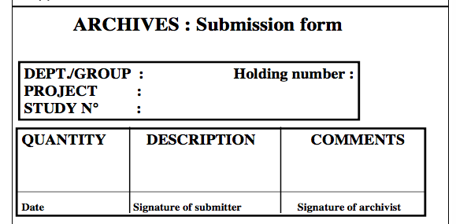

Slide 53
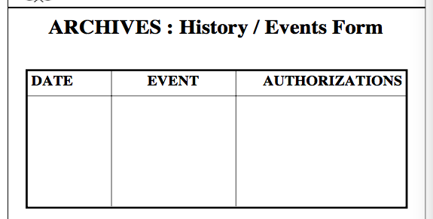

Slide 54
CONDITION of ARCHIVES
TERM of STORAGE
  Protection against fire, flood and vandalism, if possible
  Storage conditions should minimize deterioration
    Fire, flooding precautions?
    Air conditioned / ventilated general environment?
    Copies of data recorded on heat sensitive papers?
    Refrigeration used where necessary?
    Paraffin blocks sealed in bags / tissues in preservatives / cover slips on slides?
    Computer back-ups maintained in security cabinet?
    CCTV monitoring?
  The OECD GLP Principles → organizations follow national regulations for the period of archiving
    Register compounds internationally → files need to be archived indefinitely
    Varying retention times required by different GLP/GCP/GMP process
  Research facilities → impose strict rules on the destruction of archived materials
    Space problem arises, very old holdings and abandoned projects may be destroyed (belonging to chemical families of no current interest; upon justification and written authorization from management)
    If a company goes out of business, product license holders at that time should be notified and archival responsibility transferred.

Slide 55
RETRIEVAL from ARCHIVES
  Only authorized entry permitted (as per SOP)
  Examination in-situ of documents is preferred in presence of the archivist
  Photocopies made in place, if possible
  Any removal of items from the archives should only be allowed in exceptional circumstances.
    Removal should be authorized in writing by senior management.
    The history of each holding is recorded and signed by the archivist and the person taking responsibility for the material removed.

Slide 56
Indexing is often computerized
  Allows complete and rapid retrieval starting from any one of the indexing parameters
  Indexing parameters :
    Unique holding numbers
      cross-referenced to location in archives
    Project or study number
    Test article / reference article and lot numbers for test items and formulation, if required
    Protocol number (often same as study number)
    Testing facility or site identifier
    Keyword retrieval from study title / comments section of master schedule
      Regulatory information
      Dates
    Department

Slide 57
4.1 Calibration Records
CALIBRATION
RECORDS
  Proof that equipment is performing to specifications
      Generating reliable data (analytical equipment)
      Maintaining certain specified conditions (AC / fridge / incubators)
  Periodic checking
  Logbooks to record regular verifications
  Records of cleaning, repairs and routine maintenance
  Full documentation of all tests for suitability and calibration
  Data readily available during investigation of result of a study or regulatory inspections
  Archiving
ADEQUATE
EQUIPMENT
  To perform a study properly
  Suitable for intended use
      Depends on type of study and study objectives
      Suitability can only be assessed by considering the performance of the equipment
Lab must decide the acceptable frequency of calibration
  Depend on equipment and its use
Calibration programme should be included in the SOPs of the test facility
CALIBRATION
Equipment must be calibrated and maintained to ensure accurate performance
  Calibration depends on the use of standards
      Weighing balance → standard certified weights
      pH meter → standard buffer / capsules
Standards may also be compound samples of known concentration or weight
      Ensure analytical equipment is functioning as expected
      Provide basis for calculation of accuracy and precision

Slide 58
4.2 Validation of Methods
Bioanalytical methods used in nonclinical safety studies are validated to demonstrate
  Reliability
  Reproducibility
  Quality of data / product
A GLP compliance program ensures data integrity via method-validation studies
Although assay validation is not directly addressed in GLP regulations, but it is always encouraged by FDA to adopt validated methods.

Slide 59
FDA guideline ‘Guidance for Industry: Bioanalytical Method Validation’
  States that analytical laboratory conducting pharmacology/toxicology and other preclinical studies should adhere to FDA’s GLP regulations
Quality Assurance Unit (QAU) responsible for method validation studies for GLP compliance
  Good understanding of method validation concepts and regulatory requirements
    Help QAU to focus on key areas
    More effective auditing of method validation protocols, final reports and associated data

Slide 60
Full
Validation
02
Partial Validation
  Often required when new bioanalytical methods are developed
  Required when already validated methods are modified
    Method used to detect new drug entity
    Metabolites addition to existing method for quantification
Types of method validation studies
01
  Validation exercise depends on intended used of the method
Cross Validation
  Within the same study or across different studies
  When two or more methods are used to generate data
03
  Comparison of validation parameters

Slide 61
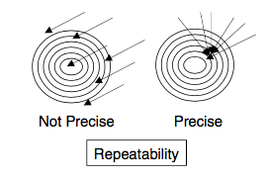
Parameters for method validation
Repeatability/Precision
  Closeness of the results between a series of measurements of a single sample by single analyst
  Under the same operating conditions
  Over a short interval of time
  Also called as “intra-assay precision”
  Often mathematically expressed as percent of coefficient of variation (% CV)

Slide 62
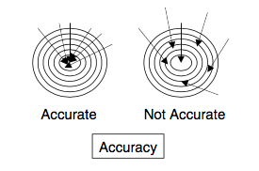
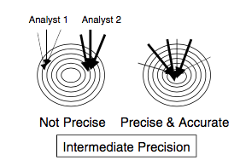
Accuracy
  Is the measure of closeness or agreement between the measured value and the true value (or accepted reference value of an analyte)
  Often expressed as percent of true or actual value
Intermediate Precision
  Is assay-to assay variability within laboratories
  Can be due different analyst, instruments or days

Slide 63
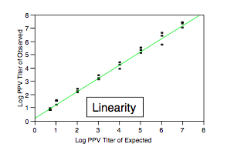
Linearity of method
  ability within a given range to elicit results that are directly proportional to concentration of analyte
  Reported as the variance of the slope of the regression line or linear regression coefficient (R²)

Slide 64
Quantification limit
  Refers to the lowest level of an analyte in a sample that can be quantitatively determined with suitable precision and accuracy
Selectivity
  Ability of the method to differentiate and quantify the analyte in presence of other components in the sample
Stability
Robustness
  Measure of a method’s capacity to remain unaffected by small, but deliberate variations in method parameters
  Indication of reliability of method

Slide 65
5. Quality Assurance (QA)
GLP defines the minimum quality assurance requirements to ensure validity of experimental results
QA is charged with assuring management that GLP compliance has been attained within lab
Should act as an independent unit (as per GLP)
  QA must review all phases of preclinical research
    From planning to reporting and archiving
  Embraces all the procedures necessary to provide a high probability that a medicine will conform consistently to a specified description of quality
  Must have access to all documents and procedures at all levels of organization

Slide 66
A. Protocol Review
QA reviews protocol (or study plan)
Mandatory process
  Completeness
  Clarity
  In case of amendments
Protocol signed by QA
Original signed copy archived

Slide 67
B. SOP Review
SOPs are essential
Reviewed and signed by QA
Not mandatory, a recommendation
  Signed SOP indicate GLP-compliance
  Complete
  Clear
  No conflict
Approved, distributed and archived
  QA approval doesn't guarantee sound technical content
  Technical content → Study Director

Slide 68
C. Master Schedule
Master schedule is a list of all studies at the facility
  A study should be entered into master schedule sheet (MSS) before the study begins (often before protocol is written)
QA maintains MSS
QA must be aware of all planned studies
  Must have copy of all studies
  Direct access
  Plan inspections and audits

Slide 69
D. Audits and Inspections
Audit
  Methodological evaluation
  Should be performed in cooperation with the people whose operations are being studies
Often internal audits and inspections are planned with study director

Slide 70
1. STUDY-BASED AUDIT
  Protocol or study plan
  Target specific critical phase of the study
    Criticality determined by QA
    Usually required input from scientists / specialists
    Use risk analysis techniques
  Reports (raw data) can also be reviewed
  Reported to study director
    for response
    improvement

Slide 71
2. SYSTEM OR FACILITY-BASED AUDIT
  Performed independently of studies
    Personnel records
    Archives
    Animal receipt, disposal
    Cleaning
    Computer operations and security
    Access and security
    SOP management
    Water supply
    Building / Equipment
  Frequency of audit depends on impact of study
  May use risk-analysis techniques
  Reported to appropriate manager of test facility

Slide 72
3. PROCESS-BASED AUDIT
  Performed independently of specific studies
  Conducted to monitor processes of a repetitive nature
  Frequency may be justified by a risk analysis approach
  Performed because it is considered inefficient or inappropriate to conduct study-based inspections on repetitive phases
  Other useful process-based inspections are those that focus on cross-organizational processes
    the transfer of test samples from the animal facilities to the bio-analysis laboratory

Slide 73
FINAL REPORT/ RAW DATA AUDIT
  QA should audit all reports from GLP studies wrt
    Protocol
    SOP
    Raw data
  To ensure that the report gives a complete and truthful account of the way in which study was performed
  Accurate representation of data
  Authenticity is checked – signatures, dates, amendments, corrections, deviations etc

Slide 74
QA statement is placed in report
  Provides dates on which study was inspected
Reported to study director and management
  QA statement is not a GLP compliance
  Study director’s responsibility
  As per OECD
    “It is recommended that the QA statement only be completed if the study director’s claim to GLP compliance can be supported. The QA statement should indicate that the study report accurately reflects the study data. It remains the study director’s responsibility to ensure that any areas of non-compliance with the GLP principles are identified in the final report”.

Slide 75
Content of QA Statement / Audit report
  Date of inspection
  Date of findings to study directors and management
  Phases audited
  Confirmation that report reflects methods used and data generated
  Sign only if GLP compliance statement from study director is considered justifiable and all corrective actions have been completed

Slide 76
The signed QA statement becomes a “release” document assuring that :
  the study report is complete and accurately reflects the conduct and data of the study;
  the study was performed in compliance with GLP;
  that all audit comments have been satisfactorily resolved.
QA audit reports are not for general distribution
  Should be handled with discretion
  Better to archive separately from study files
    No access to external auditors

Slide 77
Thank you.

